Slide 1
GRAVITY
Year 12

Slide 2
Page Setup
Set up the first page of every lesson like this and rule a column line for every page after the first page that is used during the lesson.
Focus: State the Chapter Number, Title and the page numbers (3 lines).
Keywords: During the lesson write out your own keywords used during the lesson. (8 lines)
Context: During the lesson write in this section what this topic relates to in the ‘real’ world. How is this content used to better society? (5 lines)

Slide 3
Gravitational FIELDS & Forces
Chapter 2.1 & Chapter 2.2
Page 46 – 50 & Page 50 – 58

Slide 4
Gravitational FORCE
A force of attraction that acts between any bodies or objects.
NEWTON’S LAW OF UNIVERSAL GRAVITATION
F_{g} = GMm
r ²
where F_{g} is the gravitational force acting on each body (N),
M and m are the masses of the bodies (kg)
r is the distance between the centres of the bodies (m). G (universal gravitational constant)
= 6.67 × 10 ^{–11} N m² kg^{–2}.

Slide 5
Gravitational FORCE
The extremely small value of the universal gravitational constant gives an indication of why gravitational forces are not noticeable between everyday objects.
Example 2.1a: Take two of you sitting together. Say you both weigh 70kg and sit about 30cm apart. The gravitational force of attraction, F_{g}, between these bodies is given by:
F_{g} = GMm
r ²
F_{g} = (6.67 × 10 ^{–11})(70)(70)
(0.3)²
F_{g} = 3.63 × 10 ^{–6} N attraction
This force is so small and insignificant.
M = 70 kg
m = 70 kg
r = 0.3 m
G = 6.67 × 10 ^{–11}

Slide 6
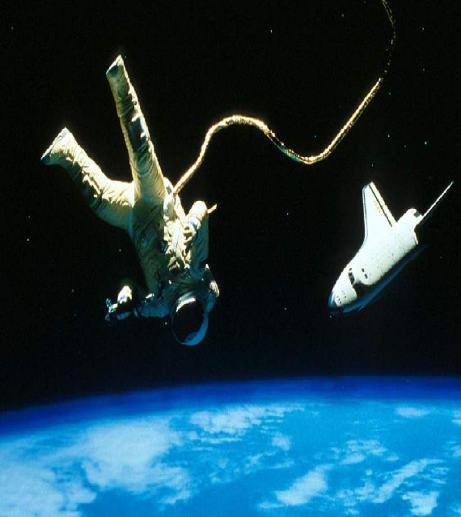
Newton’s Law of Universal Gravitation
Every mass attracts every other mass with an attractive force which is directly proportional to the product of the masses and inversely proportional to the square of the separation between them.
F
F

Slide 7
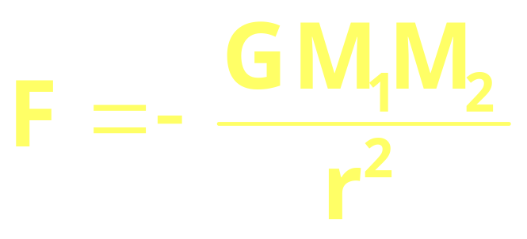
Newton’s Law of Universal Gravitation
Inverse Square Law
r
M₁
M₂
F
F
The negative sign merely indicates that the force and the distance are measured in opposite directions.
G = the universal constant of gravitation
G = 6.67 x 10⁻¹¹ N m² kg⁻²

Slide 8
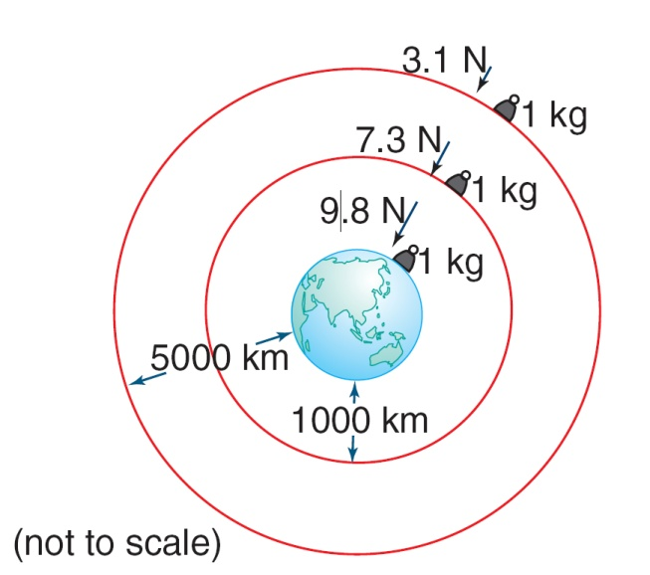
GRAVITIONAL FORCE
Gravitational forces are always forces of attraction.
The force that the 1.00 kg mass pushes down on the Earth decreases as you move further from the centre of the Earth.

Slide 9
Newton’s INVERSE SQUARE LAW
Distance (m) | Force (N) | Landmark
0 | 9.7827 | Sea Level
324 | 9.7817 | Eiffel Tower, France
830 | 9.7802 | Burj Khalifa, Dubai
2228 | 9.7759 | Mt Kosciuszko, Australia
6000 | 9.7643 | Cirrus Clouds
8848 | 9.7556 | Mt Everest, Nepal
100000 | 9.4831
160000 | 9.3099 | Low Earth Orbit (LEO) Satellites
400000 | 8.6625 | International Space Station
500000 | 8.4125

Slide 10
Newton’s INVERSE SQUARE LAW
Distance (km) | Force (N)
0 | 9.7827
100 | 9.4831
500 | 8.4125
1000 | 7.3111
2500 | 5.0498
5000 | 3.0748
10000 | 1.4841
25000 | 0.4044
50000 | 0.1253
Force never reaches zero when one object is apply a force on the other (ignoring all other masses).

Slide 11
Gravitational Field Strength
Field Lines show the direction of the field. Field Strength is a VECTOR quantity
Earth’s Surface
On a small scale, the field can be regarded as uniform.
On a large scale, gravity field lines are radial.
Clearly show or state that the lines entering or exiting an object are perpendicular.

Slide 12
Gravitational Field Strength
The GRAVITATIONAL FIELD STRENGTH is given by:
g = GM
r²
where g is the gravitational field strength (N kg^{–1} or m s^{–2}),
G is 6.67 × 10^{–11} N m² kg^{–2},
M is the mass of the object (kg) and
r is the distance from the centre of mass of the object (m).

Slide 13
Gravitational Field Strength
The WEIGHT of a body is given by:
F_{wt} = mg
where m is the mass of an object (kg), and
g is the gravitational field strength at that surface (measured in N kg^{–1}).
For Earth this is 9.8 m s^{–2}

Slide 14
Gravitational FORCE & Field Strength
Example 2.1b: A 10.0 kg watermelon falls a short distance to the ground. If the Earth has a radius of 6.38 × 10⁶ m and a mass of 5.97 × 10²⁴ kg, calculate the:
gravitational force that the Earth exerts on the watermelon
gravitational force that the watermelon exerts on the Earth.
acceleration of the watermelon towards the Earth
acceleration of the Earth towards the watermelon.

Slide 15
Gravitational FORCE & Field Strength
Example 2.1c: Calculate the gravitational field strength, g, at the surface of the Moon (mass of Moon is 7.35 × 10²² kg, radius of Moon is 1.74 × 10⁶ m).
Example 2.1d: Determine the weight of an astronaut, whose total mass is 100.0 kg, if he was on the Moon.

Slide 16
Gravitational FORCE & Field Strength
Example 2.1e: An astronaut travels away from Earth to a region in space where the gravitational force due to Earth is only 1.00% of that at Earth’s surface. What distance is the astronaut from the Earths surface?

Slide 17
Gravitational FORCE & Field Strength
Example 2.1f: The gravitational force that acts on a 1.20 × 10³ kg space probe at the equator on the surface of Mars is 4.43 × 10³ N. The radius of Mars is 3397 km at the equator. Without using the mass of Mars, determine the gravitational force that acts on the space probe when it is:
3397 km above the surface of Mars
6794 km above the surface of Mars.

Slide 18
Homework, Context & Keywords
Context: How is this content used to better society?
The application of gravity with respect to the motion of objects.

Slide 19
Homework, Context & Keywords
Key Words
Gravitational Force
Gravitational Field
Gravity
Inverse Square Law
Field lines
Universal Gravitational Constant

Slide 20
Homework, Context & Keywords
Homework
Complete all questions from Set 2.1 & 2.2 - due first lesson next week.
No Chapter to read by next lesson.

Slide 21
Page Setup
Set up the first page of every lesson like this and rule a column line for every page after the first page that is used during the lesson.
Focus: State the Chapter Number, Title and the page numbers (3 lines).
Keywords: During the lesson write out your own keywords used during the lesson. (8 lines)
Context: During the lesson write in this section what this topic relates to in the ‘real’ world. How is this content used to better society? (5 lines)

Slide 22
Satellites
No Chapter

Slide 23
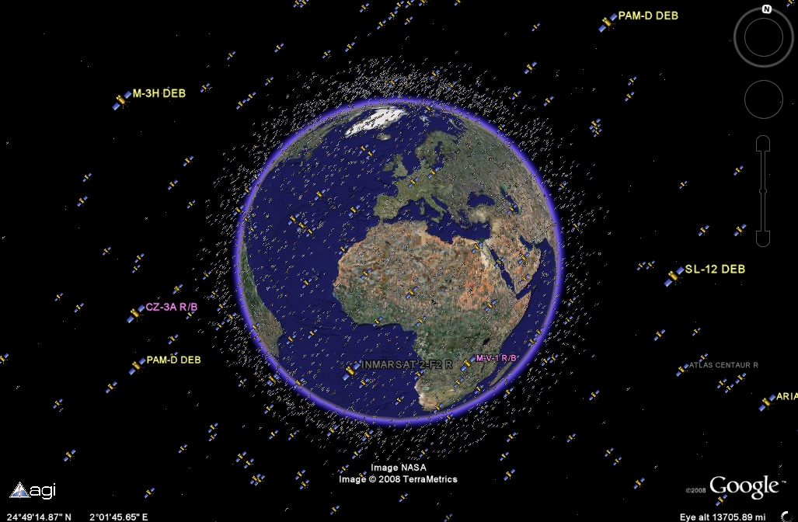
Artificial Satellites

Slide 24
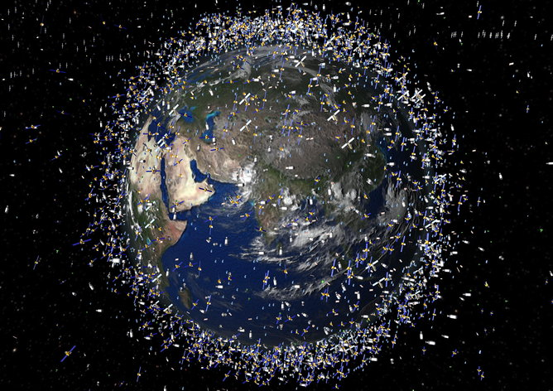
Artificial Satellites

Slide 25
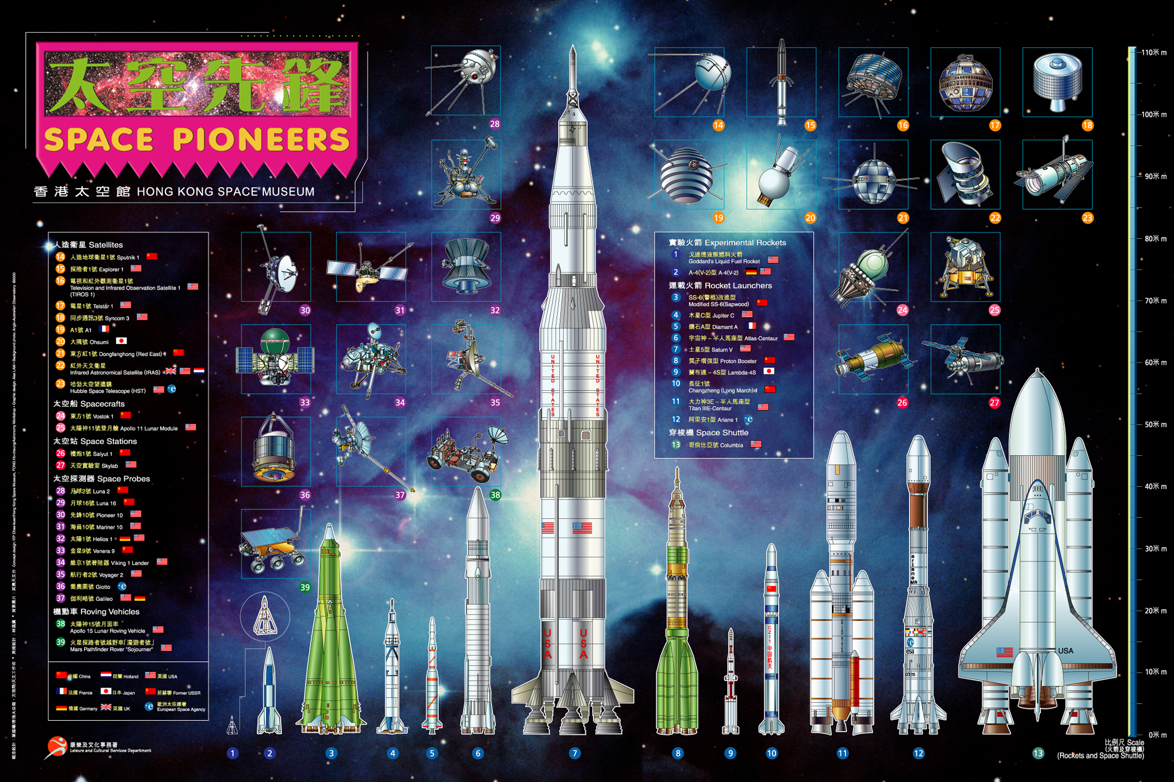
Artificial Satellites

Slide 26
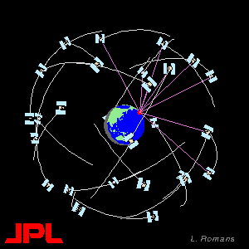
Low EARTH Orbit Satellites
Limited in use as they complete up to 15 rotations around the Earth each day and so will be in range with their “home” country for only small portions of the day.
ISS is an example of a LEO.
Watch the purple lines.

Slide 27
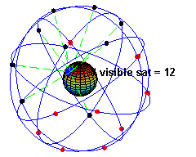
Low EARTH Orbit Satellites
Many satellites are placed strategically in a particular orbit so that constant communication can occur between the satellites themselves and
with the “home” site.
Watch the red dots are out of range and the black dots are in communication range.

Slide 28
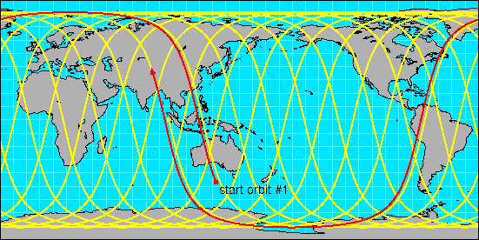
Geostationary & Geosynchronous Satellites
Geostationary satellites orbit the Earth over the equator with a period of 23 hours, 56 minutes and 4 seconds (one sidereal day). The geostationary satellite will occupy the same position in space above the Earth. Ideal for communication and weather.
Geosynchronous satellites orbit with a period of 23 hours, 56 minutes and 4 seconds, but not along the equator. This means the satellites
have to trace a complicated
pattern across the Earth as
it and the Earth rotate in
different alignments. Ideal
for spying.

Slide 29
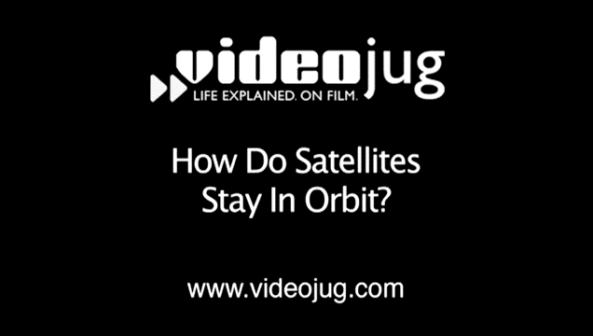
Geostationary Satellites

Slide 30
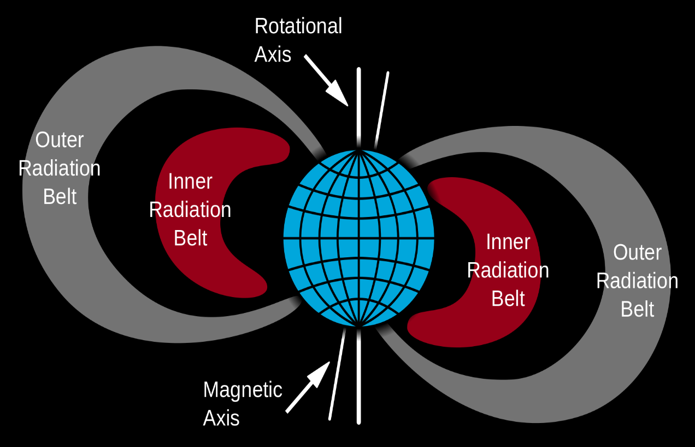
Van Allen belt
Is a “radiation belt“ is a layer of energetic charged particles that is held in place around a magnetized planet, such as the Earth, by the planet's magnetic field.
The Earth has two
belts and sometimes
others may be
temporarily created.

Slide 31
Van Allen belt
The Van Allen belts endanger satellites, which must protect their sensitive components with adequate shielding if their orbit spends significant time in the radiation belts.
The belts contain energetic electrons that form the outer belt and a combination of protons and electrons that form the inner belt. The radiation belts additionally contain lesser amounts of other nuclei, such as alpha particles.

Slide 32
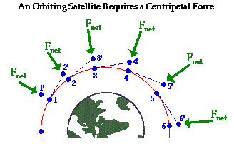
Artificial & Natural Satellites
Artificial and Natural Satellites are not propelled by rockets or engines. They orbit in free-fall.
Artificial Satellites
are equipped with
tanks of propellant
that are used to
adjust the satellites
course.

Slide 33
Natural Satellites
Include;
Planets
Asteroids
Comets (that are in a known repetitive orbit)
Moons (that orbit a planet)
Planetesimals
Any non-manmade astronomical body that has a regular orbit around another astronomical body.

Slide 34
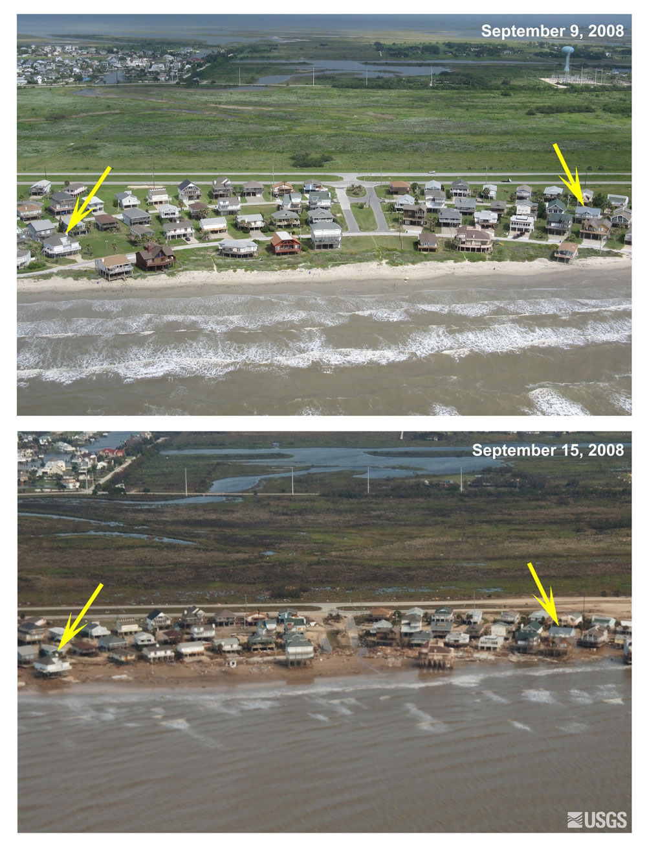
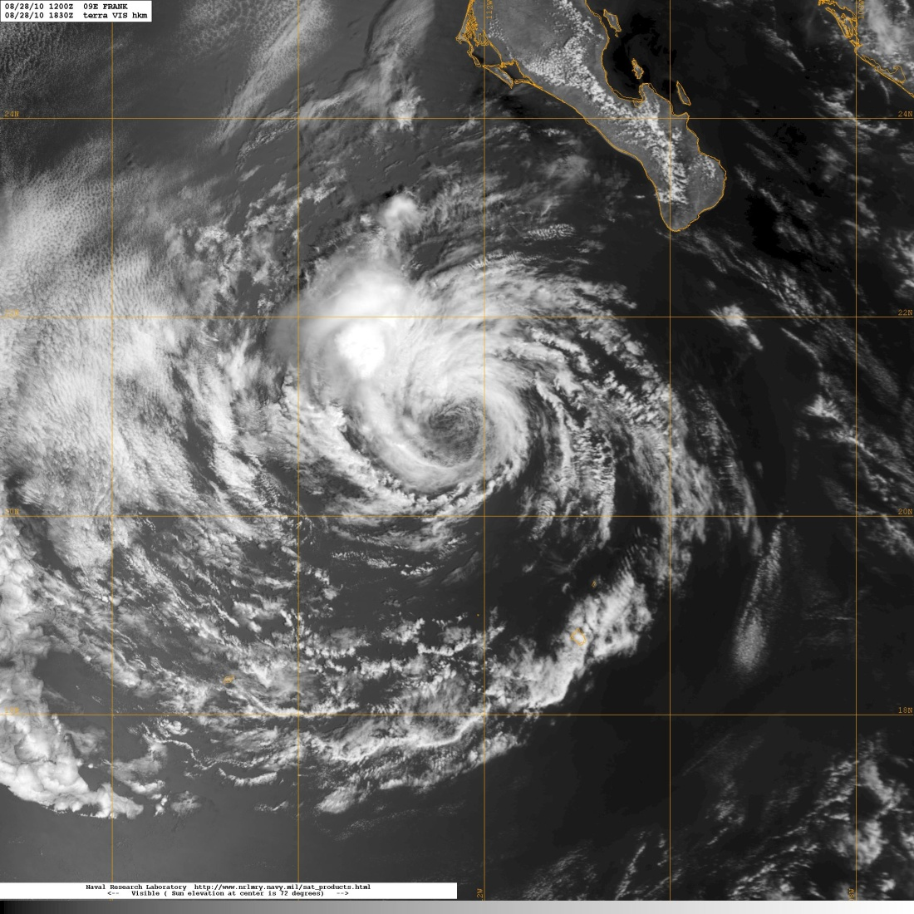
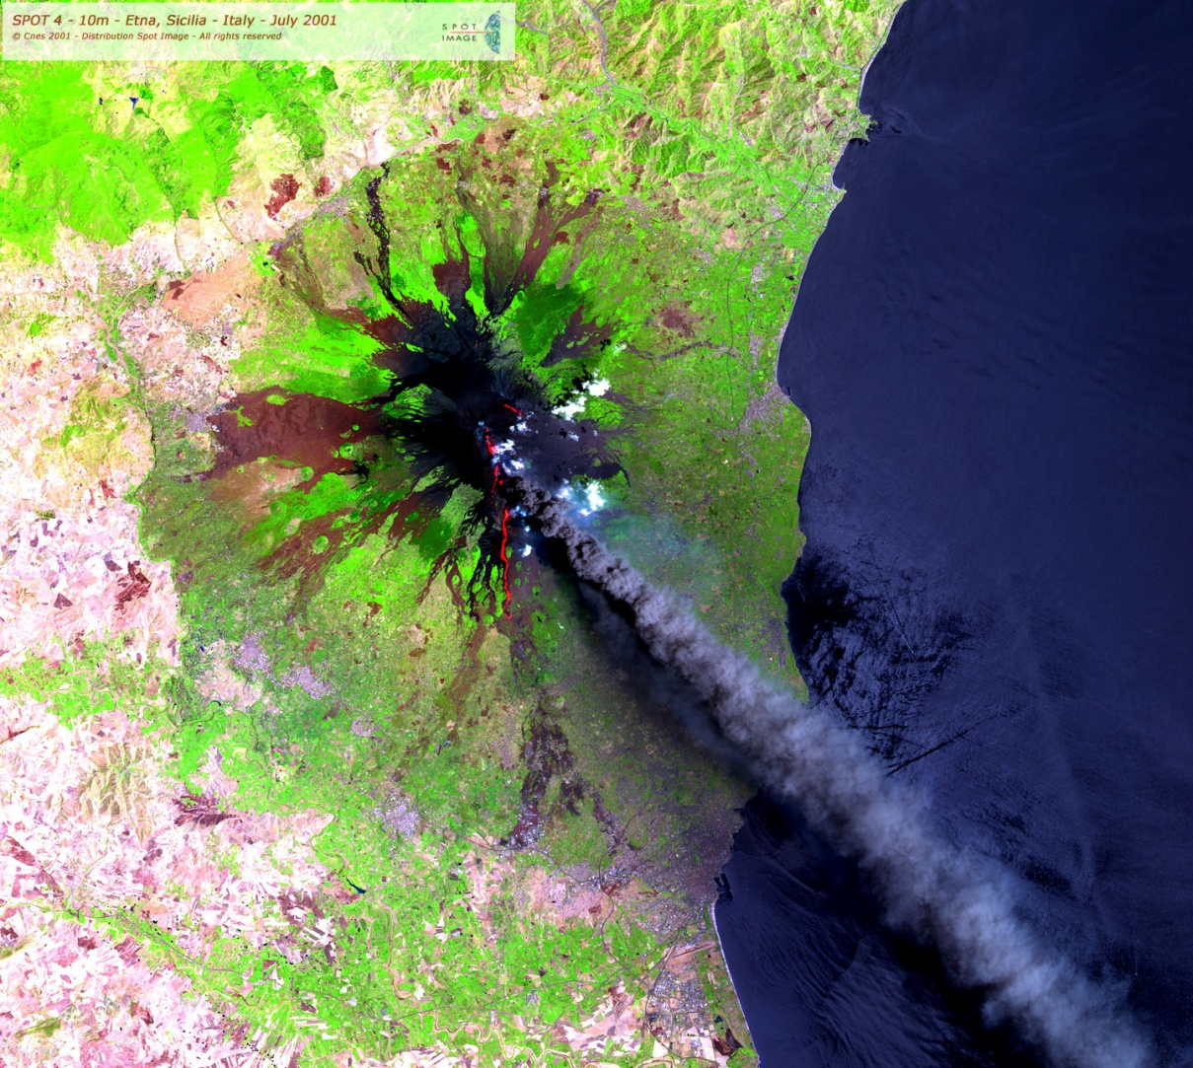
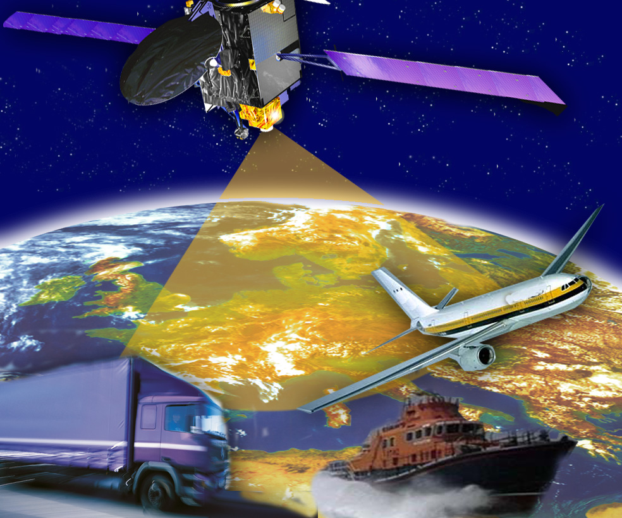
Investigating Earth from Space
Consider what you can
learn from close-up
versus distant views.
Monitoring Volcanoes
Monitoring Storms
Communicating between Transport companies
Flooding and coastal disasters

Slide 35
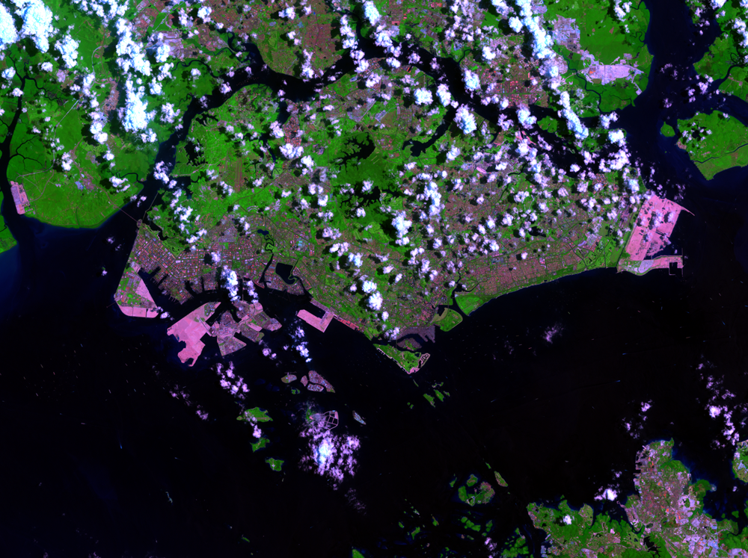
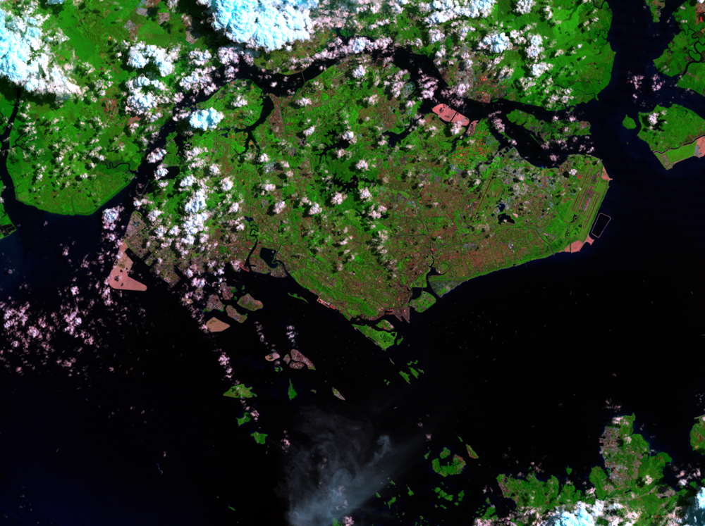
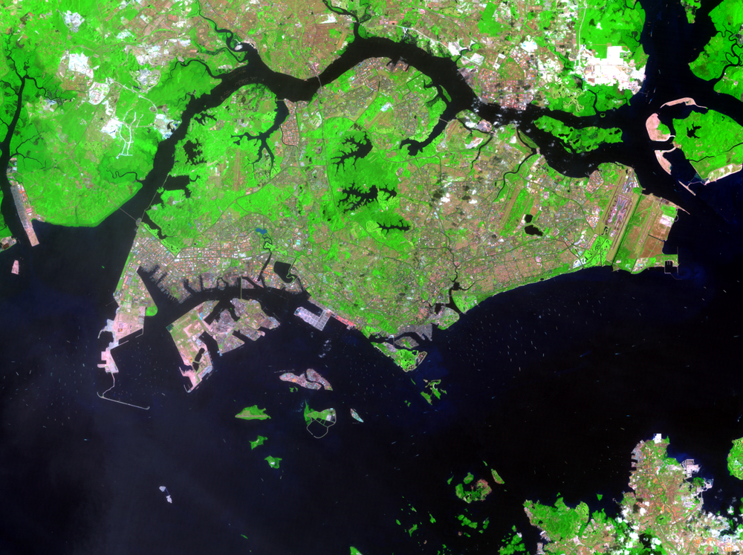
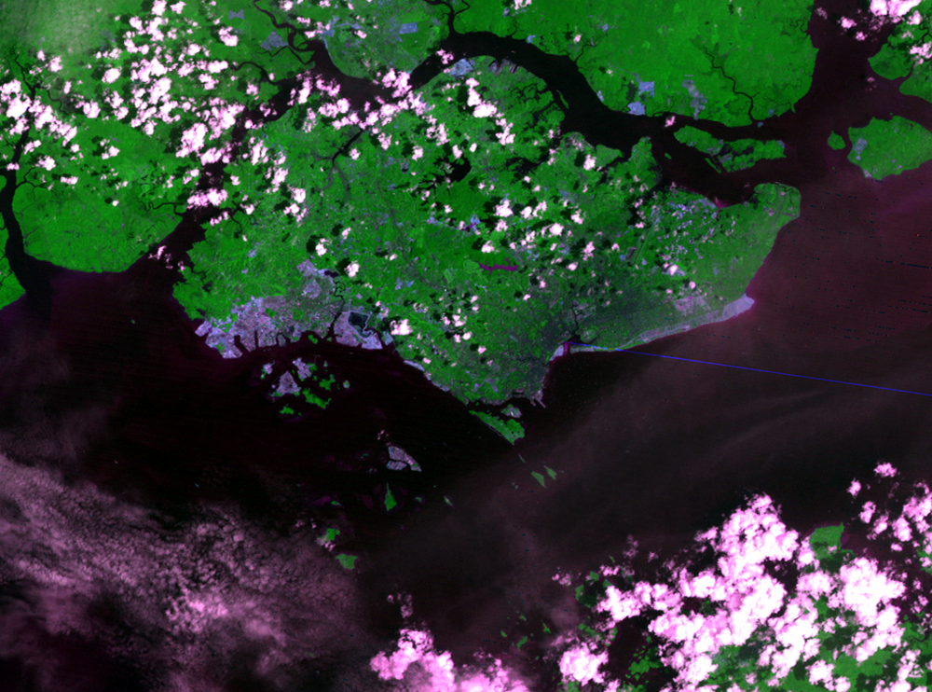
Investigating Earth from Space
“Buy land,” a wise man once said. “They’re not making any more.” Singapore is refuting that comment.
2009
2000
1989
1973

Slide 36

ARTIFICIAL Satellites

Slide 37
Homework, Context & Keywords
Context: How is this content used to better society?
The uses of satellites as a form of GPS or monitoring of Earth events.

Slide 38
Homework, Context & Keywords
Key Words
Satellites
Natural
Artificial
LEO
Geostationary
Geosynchronous
Van Allen Belt
Radiation belt

Slide 39
Homework, Context & Keywords
Homework
Complete all questions from Set 2.1 & 2.2 - due first lesson next week.
Read Chapter 2.4, page 62-68 and answer
Q1 & Q2 Set 2.4
by next lesson.

Slide 40
Page Setup
Set up the first page of every lesson like this and rule a column line for every page after the first page that is used during the lesson.
Focus: State the Chapter Number, Title and the page numbers (3 lines).
Keywords: During the lesson write out your own keywords used during the lesson. (8 lines)
Context: During the lesson write in this section what this topic relates to in the ‘real’ world. How is this content used to better society? (5 lines)

Slide 41
KEPLER’S Laws & Satellite Motion
Chapter 2.4
Page 62 – 68

Slide 42
Kepler’s Laws of Planetary Motion
In the early 1600s, Johannes Kepler proposed three laws of planetary motion.
Kepler described the motion of planets in a sun centred solar system as;
The Law of Ellipses
The Law of Equal Areas
The Law of Harmonies

Slide 43
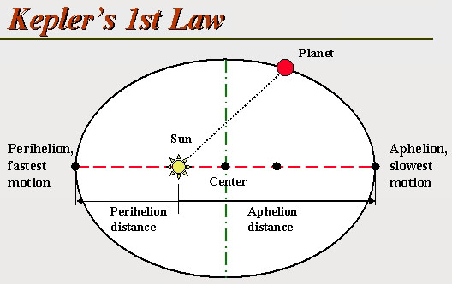
Law of Ellipses (First Law)
All planets move in elliptical orbits with the Sun at one focus and the other focus empty.
Major Axis

Slide 44
Law of Ellipses (First Law)
Major Axis
Eccentricity (e) = distance between the foci
length of the major axis

Slide 45
Law of Ellipses (First Law)
Example 2.4a: What shape would have an eccentricity of e = 0.0?
A circle, as both foci would need to be located at the same point so the distance between the foci is zero.
e = distance between foci
length of major axis

Slide 46
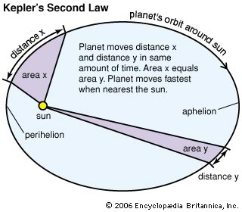
Law of Equal Areas (Second Law)
An imaginary line drawn from the centre of the sun to the centre of the planet will sweep out equal areas in equal intervals of time.
Hence the sweeping velocity changes.

Slide 47
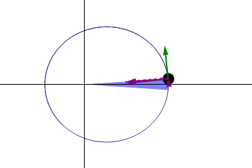
Law of Equal Areas (Second Law)

Slide 48
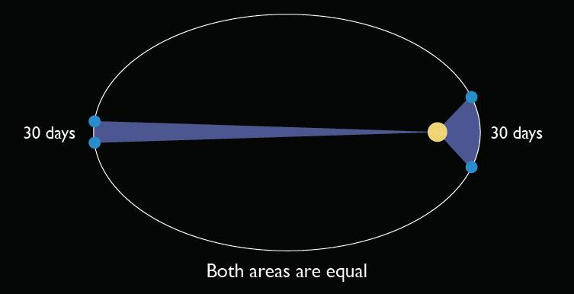
Law of Equal Areas (Second Law)
Example 2.4b: Halley’s Comet orbits around the Sun once every 75 years with an eccentricity of 0.967. If at the aphelion it is 35.2 AU away and at the perihelion it is only 0.603 AU away from the Sun and is recorded at speeds of 54.4 km s⁻¹ when whipping around the Sun. Estimate the speed at the furthest point from the Sun.

Slide 49
Law of Equal Areas (Second Law)
Example 2.4b: continued
h₁
h₁
h₂
t₂
A₂
A₁
t₁

Slide 50
Law of Harmonies (Third Law)
The squares of the orbital periods of the planets are directly proportional to the cubes of the mean distances from the Sun.
K = r³ = G M .
T² 4 π²
where K is Kepler’s constant

Slide 51
Law of Harmonies (Third Law)
This is based on the principle that in order for a planet to remain in orbit then the force due circular motion, wanting it spiral outwards must be matched by the gravitational force of the Sun, trying to pull it in.
Hence F_{c} = F_{g}
mv² = GMm .
r r² where v = 2πr .
T
Rearranged and
r³ = G M .
T² 4 π²

Slide 52
Solar System
Using Earth as our subject for all other planets.
Planet | T (Earth yrs) | R (AU) | T² | R³ | K
Mercury | 0.24 | 0.39 | 0.06 | 0.06 | 1
Venus | 0.61 | 0.72 | 0.37 | 0.37 | 1
Earth | 1 | 1 | 1 | 1 | 1
Mars | 1.88 | 1.52 | 3.53 | 3.51 | 0.994
Jupiter | 11.86 | 5.2 | 140.7 | 140.6 | 0.999
Saturn | 29.46 | 9.54 | 867.9 | 868.3 | 1
Uranus | 84.01 | 19.19 | 7058 | 7067 | 1.001
Neptune | 164.79 | 30.06 | 27160 | 27160 | 1
Pluto | 248.5 | 39.53 | 61770 | 61770 | 1
Halley Comet | 75.2 | 17.84 | 5655 | 5675 | 1.004

Slide 53
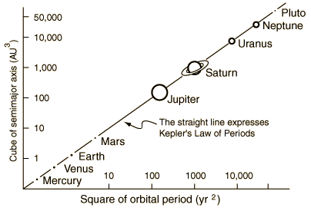
Law of Harmonies (Third Law)
The ratio of the squares of the period (T²) of the planets orbit is equal to the ratio of the cubes of the average distances (R³) from the sun.
Hence
K = R³
T²
where K is Kepler’s
constant.

Slide 54
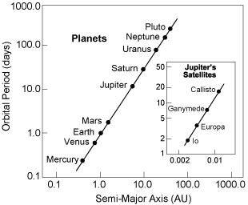
Solar System
In our solar system we use the Earth as our subject for all other planets. Even looking at Jupiter we see the same correlation with the orbiting moons.
K_{Jupiters moons} = 0.00083 m³ s⁻²
Each star system will have its own K value and this will be constant for each orbiting body in that star system.

Slide 55
Law of Harmonies (Third Law)
Example 2.4c: In 2143, just before Betelgeuse went supernova, three orbiting bodies were discovered and the following data logged. Complete the table.
Planet | T (Eth yrs) | R (m) | T² | R³ | K
Alpha Orionis B-M76 | 6.48 | 4.49 x 10¹¹ | 41.99 | 9.052 x 10³⁴ | 2.156 x 10³³
Alpha Orionis M-6J3 | 9.14 | 5.65 x 10¹¹ | 83.54 | 1.8 x 10³⁵ | 2.155 x 10³³
Alpha Orionis J-316 | 26.42 | 1.15 x 10¹¹ | 698.02 | 1.5 x 10³⁶ | 2.155 x 10³³

Slide 56
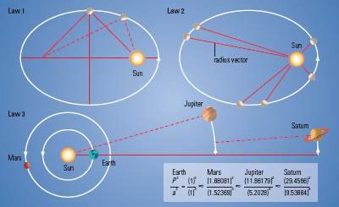
Kepler’s Three Laws

Slide 57
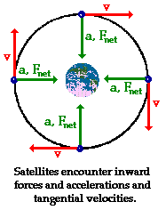
Calculating Satellite Orbits
For a circular orbit there is no acceleration in the direction of velocity, only acceleration towards the centre of the body.
Hence in the direction of the angular velocity
v = s = 2 π r
t T
r is the radius
T is the period of rotation

Slide 58
Satellite Acceleration
The acceleration due to gravity has to match the centripetal acceleration in order for it to remain in orbit.
a_{c} = v² = 4 π ² r = GM = g
r T² r²
G = 6.67 x 10⁻¹¹ N m² kg⁻²
(Universal Gravitational Constant)

Slide 59
Satellite Acceleration
Example 2.4d: The spin dryer of an automatic washing machine is 48.0 cm in diameter. While spin drying a load of washing it rotates at 150 rpm.
Determine the maximum acceleration of an article of clothing spinning inside the dryer.
How does this compare with the acceleration due to gravity?
Explain how the dryer is able to remove water from the clothes by this process.

Slide 60
Satellite Acceleration
Example 2.4e: A tumble dryer is designed so that it will “air” clothing by allowing it to fall directly to the bottom of the tumbler rather than continually sticking to its sides. If the dryer has a 50.0 cm diameter, below what speed (in rpm) should it operate to achieve a tumbling action?

Slide 61
Satellite Force
F_{c} = mv² = 4 m π² r = GMm = F_{g}
r T² r²
Satellite Acceleration
a_{c} = v² = 4 π ² r = GM = g
r T² r²
F = ma

Slide 62
Satellite Force
Example 2.4f: Two small jars of Vegemite, each of mass 300 g are resting on a kitchen bench some 15.0 cm apart (centre to centre).
Determine the gravitational force of attraction between these two jars?
Why do they not accelerate towards each other?

Slide 63
Satellite Force
Example 2.4g: John has a mass of 55.0 kg. What will be:
His weight on the Earths surface?
His weight at an altitude of 700 km above the Earths surface?
His apparent weight while orbiting in a satellite 700 km above the Earths surface. Explain?

Slide 64
Satellite Force
Example 2.4h: Due to the Earths rotation (once every 24 hrs) a persons apparent or measurable weight is less than expected.
Where would this effect be most noticeable, at the equator or the poles of the Earth?
Calculate the maximum percentage difference that this effect will have on your measurable weight.
If you want to lose your weight completely, what should the period of the Earth’s rotation be?

Slide 65
Satellite Force
Example 2.4i:
Calculate the force of gravitational attraction that the Earth exerts on the Moon.
Calculate the force of gravitational attraction that the Moon exerts on the Earth.
What evidence do we have of the Moon’s attractive force?

Slide 66
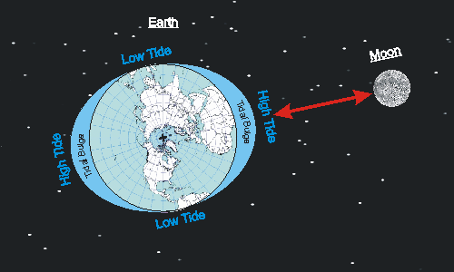
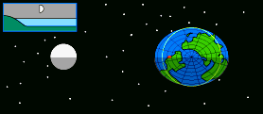
Satellite Force
Example 2.4i:
The Earths tides are influenced by the Moon’s gravity.

Slide 67
Kepler’s Laws Refreshed
The Law of Ellipses: The path of the planets about the sun is elliptical in shape, with the centre of the sun being located at one focus.
The Law of Equal Areas: An imaginary line drawn from the centre of the sun to the centre of the planet will sweep out equal areas in equal intervals of time.
The Law of Harmonies: The ratio of the squares of the period (T²) of the planets orbit is equal to the ratio of the cubes of the average distances (r³) from the sun.
Hence K = r³ = G M .
T² 4 π² where K is Kepler’s constant and M is the mass of the body being orbited, e.g the Sun).

Slide 68
Homework, Context & Keywords
Context: How is this content used to better society?
The relationship between the centripetal acceleration and the gravitational acceleration helps distinguish the type of planets orbiting distant star systems.

Slide 69
Homework, Context & Keywords
Key Words
Kepler
Law of Ellipses
Law of Equal Areas
Law of Harmonies
Perihelion
Aphelion
Eccentricity
Foci
Kepler’s constant
Gravitational versus Centripetal

Slide 70
Homework, Context & Keywords
Homework
Complete all questions from Set 2.4 - due first lesson next week.
Read Chapter 3.1, page 72-82 and answer
Q1 & Q2 Set 3.1
by next lesson.

